Slide 1
Software Engineering
Prepared by: Neha Tripathi

Slide 2
The Rational Unified Process (RUP) Model

Slide 3
RUP Model
The Rational Unified Process (RUP) is an iterative software development framework.
It was created by the Rational Software Corporation, a division of IBM since 2003.
The Rational Unified Process is a modern generic process model that is organized into phases(inception, elaboration, construction, and transition) but separates activities (requirements, analysis, and design, etc.) from these phases.
RUP incrementally grows an effective solution over multiple iterations
A modern generic process derived from the work on the UML and associated process.
3 perspectives of RUP Model
A dynamic perspective that shows phases over time;
A static perspective that shows process activities;
A practice perspective that suggests good practice.

Slide 4
Unified modeling language :The RUP is a guide for how to effectively use the Unified Modeling Language(UML). The UML is a industry-standard language that allows us to clearly communicate requirements, architectures and designs.
Tools: They are used to create and maintain visual modeling, programming, testing.
Configurable process: The Unified Process fits small development teams as well as large development organizations.

Slide 5

RUP Model representation

Slide 6
Phases in the Rational Unified Process
Inception
- Establish the business case for the system.
Elaboration
- Develop an understanding of the problem domain and the system architecture.
Construction
- System design, programming and testing.
Transition
- Deploy the system in its operating environment.

Slide 7
RUP Iterations
In-phase iteration
- Each phase is iterative with results developed incrementally.
Cross-phase iteration
- As shown by the loop in the RUP model, the whole set of phases may be enacted incrementally.

Slide 8
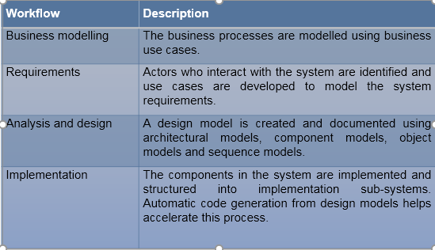
Static workflows in the Rational Unified Process ( 9 workflows= 6 core + 3 supporting)

Slide 9
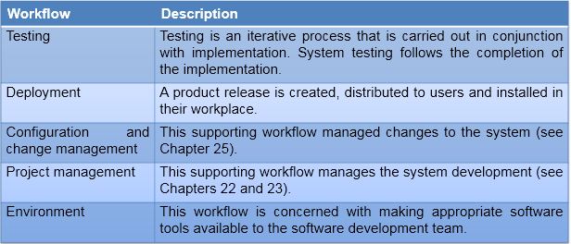

Slide 10
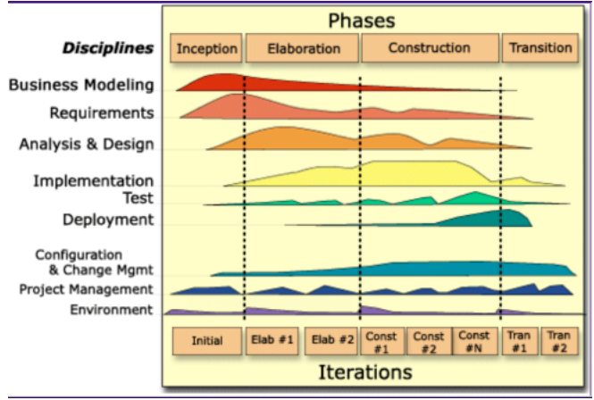
Effort Distribution of Activities

Slide 11
RUP good practice
Develop software iteratively
Plan increments based on customer priorities and deliver highest priority increments first.
Manage requirements
Explicitly document customer requirements and keep track of changes to these requirements.
Use component-based architectures
Organize the system architecture as a set of reusable components.
Visually model software
Use graphical UML models to present static and dynamic views of the software.
Verify software quality
Ensure that the software meet’s organizational quality standards.
Control changes to software
Manage software changes using a change management system and configuration management tools.

Slide 12
Thank You!

